Slide 1

TabX
Typing Assistant for Browsers
Mishig Davaadorj
Miguel Guerrero
Khayyon Parker
Russell Skorina
Nicole Woch

Slide 2
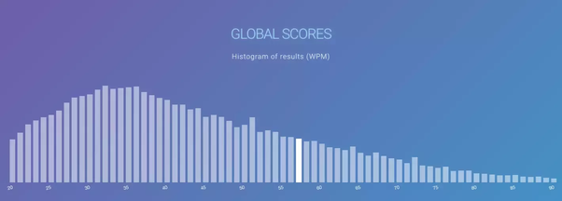
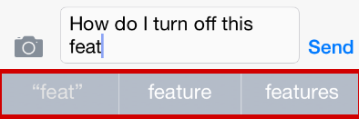
Why TabX?
Limited typing speed
Medium of computer
Solved on phone
Smart completion
Notes:
There is an epidemic. Of bad Typing.

Slide 3

Client: The Library
Notes:
-not interested in making a profit, but providing best experience for its patrons
-has many patrons who are old or unfamiliar with technology and therefore slow typists that can slow down the workflow in the library (+ fewer patrons in and out)

Slide 4

Library Goals
✓ Maximize user productivity
Typing speed
✓ User-friendly
✓ Consistently
available
✓ Accessible
Notes:
Maximize productivity - faster typing -> fewer resources and time expended = better user experience
User friendly - easy to use, flexible/easy to change settings (lots of them) (for library and potentially patrons)
Chrome extension - Availability across all/most webpages - or at least most popular
Accessible - colorblind or older patrons (hard of seeing), don’t want really tiny text or hard to read text

Slide 5

Client Goals -> Features
Client Features:
✓ Word prediction/completion
✓ Configurable display
✓ Applicable wordset
✓ Not customized to specific user
Adjustments:
Administrative settings
User interface appearance
User testing
Additional Features:
✓ Word correction
✓ Abbreviation expansion
✓ Profanity filter
✓ Ignores password fields
✓ More settings
Notes:
Configurable display - suggestions table and text display/font scheme (accessibility)
Just about all features can be turned on/off
Applicable wordset - not edgar allan poe - more accurate predictions
Public computers
No admin settings - want flexibility for users which we have with the settings, but it’s not a huge concern bc it’s not like a matter of privacy or something and the settings can always be checked at the end of the day and changed back or something - settings persist across closing browser
User interface appearance - functionality and accessibility is a priority over how it looks
User tested/user feedback - not with measurable metrics like we initially said we would (to prove results), but at least qualitative user testing (caused us to implement additional word suggestion toggle - numbers or tab)
More settings - # of suggestions to show

Slide 6
DEMO

Slide 7
Part 2: Passing the Baton - TabX Bus Accident

Slide 8
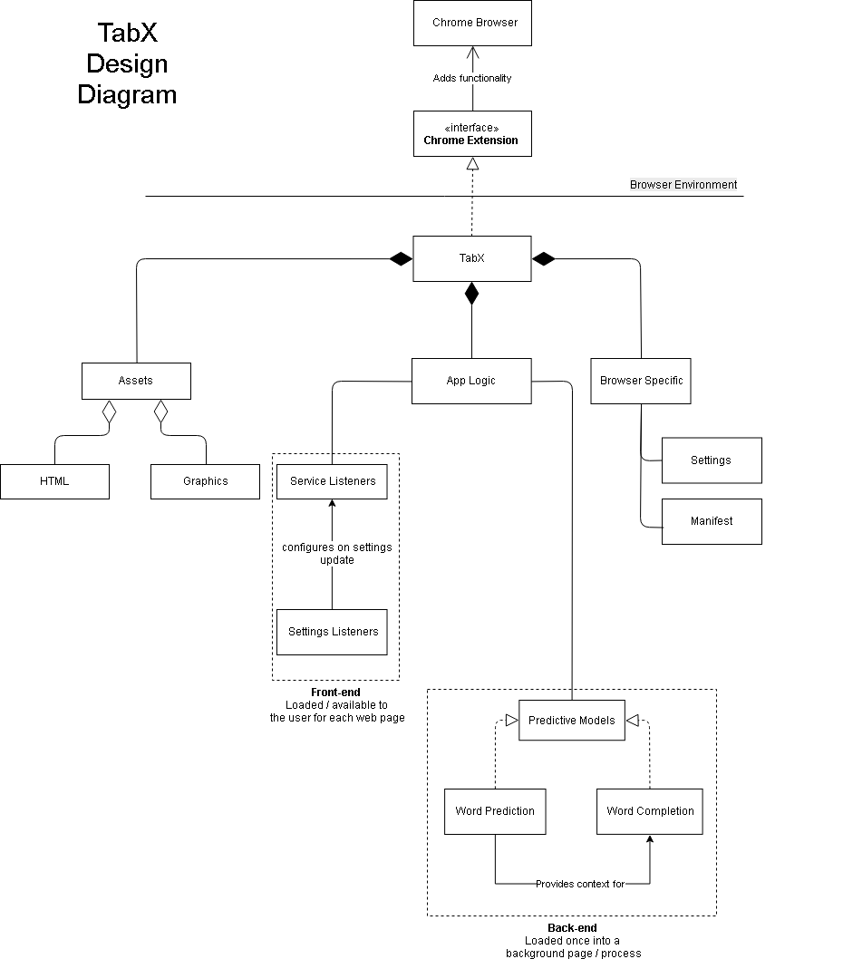
Overall Architecture

Slide 9
Subsystems: Chrome Interface
Notes:
By abiding by this interface, TabX “contractually” agreed to follow Chrome’s specifications. This puts technical constraints on the rest of TabX’s subsystem. This mainly includes that code must run in a browser environment and follows standard security protocols (e.g. CORS).

Slide 10
Subsystems: TabX
Notes:
TabX is the point-of-contact to Chrome. It is composed of three main subsystems:
The application logic
Assets and static resources
Browser specs

Slide 11
Subsystems: Application Logic
Notes:
This layer of the TabX system is responsible for scripts that can run webpages and allows users to access writing assisting services (the back-end). These subsystems are deployed separately, since they work in different processes.
It is here that the interface between the Front-end and Back-end are defined where -
The Front-end passes a string to the backend models:
And The Backend Models return a list of Suggested Words back to the front end to display the results

Slide 12
Application Logic: Predictive Models
Notes:
The Word prediction and completion models don't just appear they have to be trained, after the models are trained they are able to provide suggestions on what words the user might find helpful, in order to fulfill the obligation of the interface

Slide 13
Subsystems: Assets
Notes:
The assets subsystem contains resources that are used in displaying information to the user and separating the presentation aspect of TabX from the application logic subsystem.

Slide 14
Subsystems: Browser Specifics
Notes:
Finally, this subsystem is responsible for configuring TabX for use as a Chrome extension and to reflect user settings to TabX upon its initialization. Settings contains the necessary calls to chrome’s storage API to create a TabX instance that reflects the current user’s settings.

Slide 15


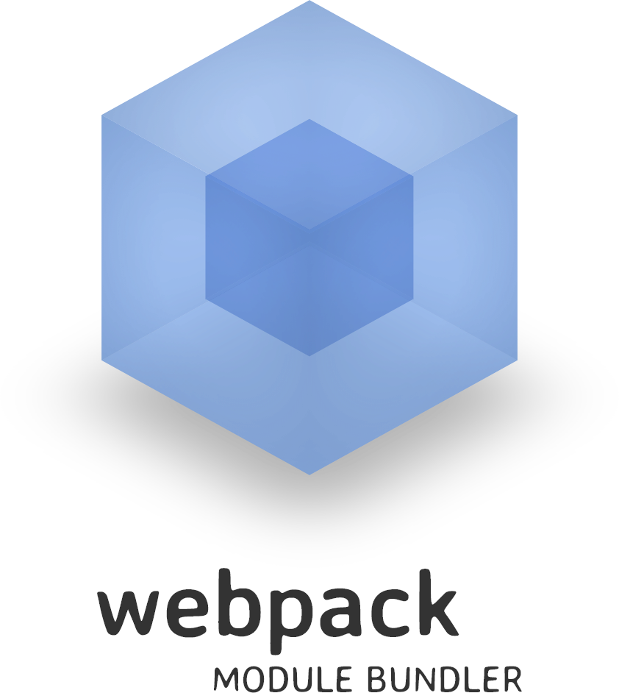
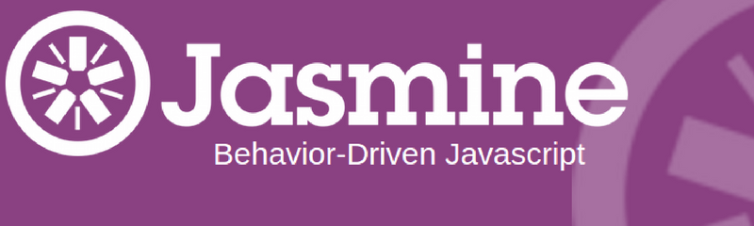

Set-up for Development Environment
TabX was developed using the following technologies:
Notes:
To set up the development environment, clone the TabX repository.
TabX was developed using the following technologies:
HTML5, CSS3, ECMAScript 7
Node.js v10.13.0, npm/npx v6.4.1
Chrome 70
Jasmine
Currently TabX has depends on the Jasmine Testing Framework for front-end development. It is not locally installed on the repository, so installing jasmine is necessary.
TabX’s specs were developed using jasmine v3.3.0 and jasmine-core v3.3.0.
Webpack
In addition, TabX requires webpack for deployment. This is used to bundle its dependencies for use in the browser. Version 4.26.1 is currently being used> npm install webpack
Note
Lastly, part of TabX development relies on installing it to Chrome. Installing TabX into Chrome is needed to test how it is operates on the browser and web applications.

Slide 16
Installation
Notes:
Insert Chrome Install Video

Slide 17
Configuration & Maintenance
Chrome Extension Interface
TabX must conform to Chrome’s extension interface
Chrome API Calls & Deprecation
TabX has explicit calls to Chrome’s APIs throughout the source code
Development Dependencies
the logic in TabX will have to be updated as the technologies are updated
Notes:
Chrome Extension Interface
If the interface were to be broken because of changes to this interface, Chrome will throw errors on the extension’s page or upon the extension’s installation. These errors includes detailed information on what’s wrong with the directory. Currently, Chrome relies on a manifest.json file to provide metadata on extensions, and it is what tell’s Chrome that a directory should be treated as an extension. Manifest.json has to be kept up-to-date to reflect Chrome’s specifications.
Chrome API Calls and Deprecation
Namely, TabX relies on Chrome’s tabs, storage, and runtime APIs. These may become deprecated and expose TabX to technical difficulties in the future. To keep TabX more flexible, abstractions on how to interact with Chrome for services (eg. storage, messaging, event listening) should be developed so that there is only one place to modify these calls.
Development Dependencies
Outside of Chrome interfacing, maintaining TabX is factored by the technologies used in its initial deployment.
- HTML5
- CSS3
- ECMAScript 7
- Node.js v10.13.0
- npm/npx v6.4.1
Compatibility for future versions have to be considered is for TabX continued development.
Maintainers should consistently update the source code to reflect the newest versions, or ensure means for older technology (esp. HTML5, CSS3, ES7) to work with newer environments.
Errors arising from lack of backwards-compatibility are expected to come up as developers work in environments with newer versions of the above dependencies.

Slide 18
Part 3: Teamwork and Reflection

Slide 19
Part 3 Template Slide

Slide 20
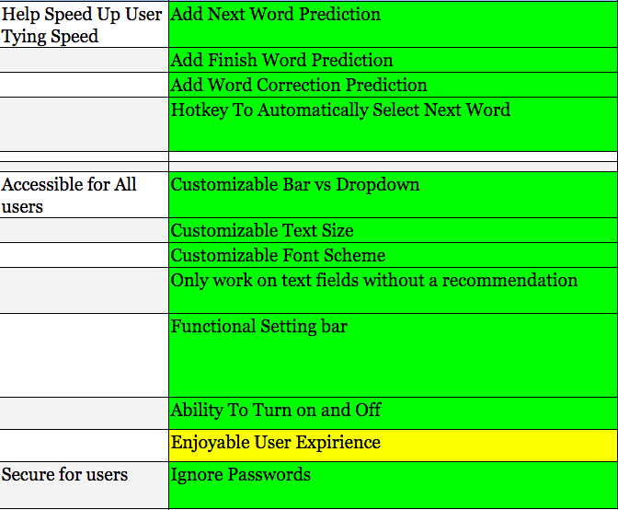
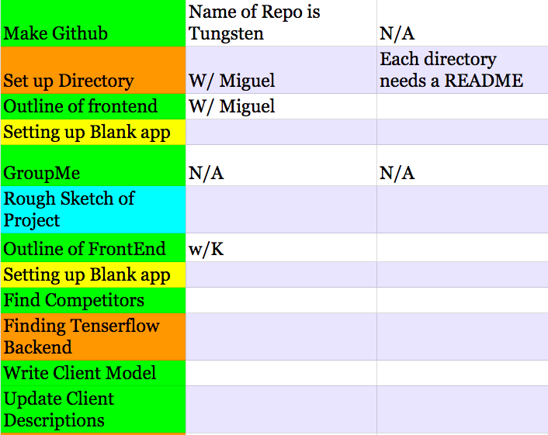
Planning
Good at Goals
Difficulty with Details

Slide 21

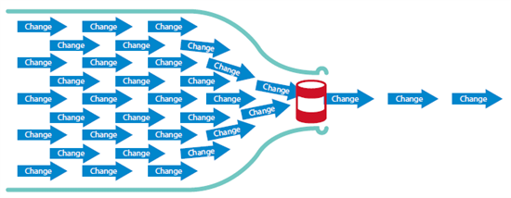
Coordination
Roll Fulfillment
Roll Fulfillment

Slide 22
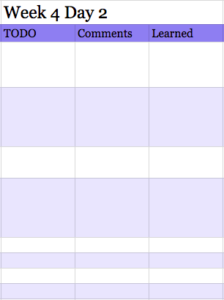

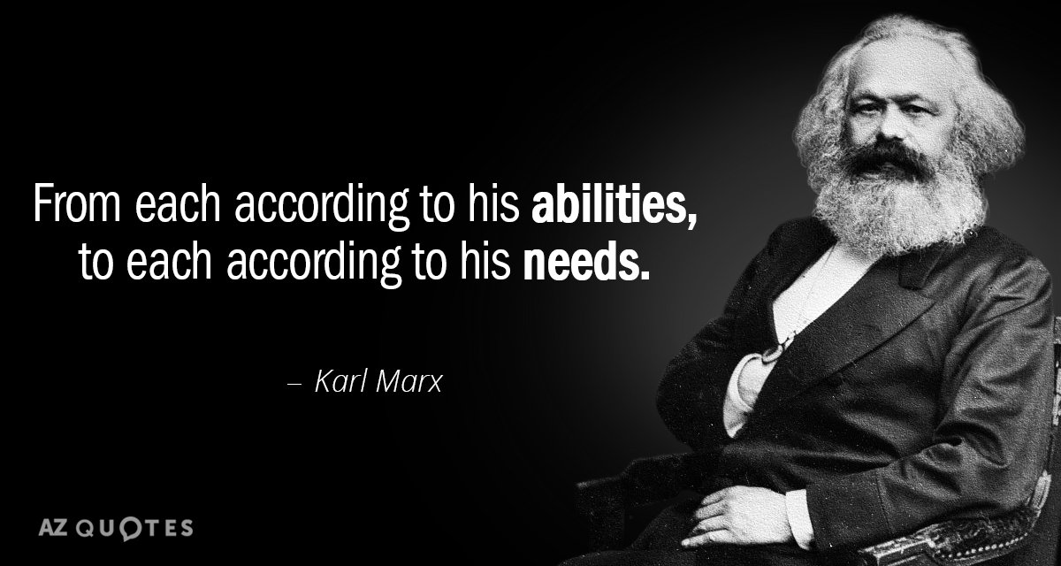
Communication
Workflow
Transfer Where needed

Slide 23
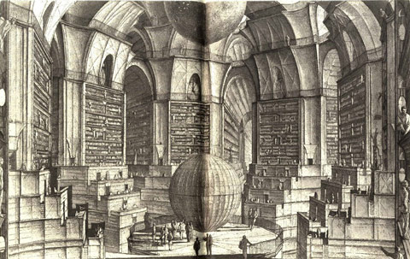
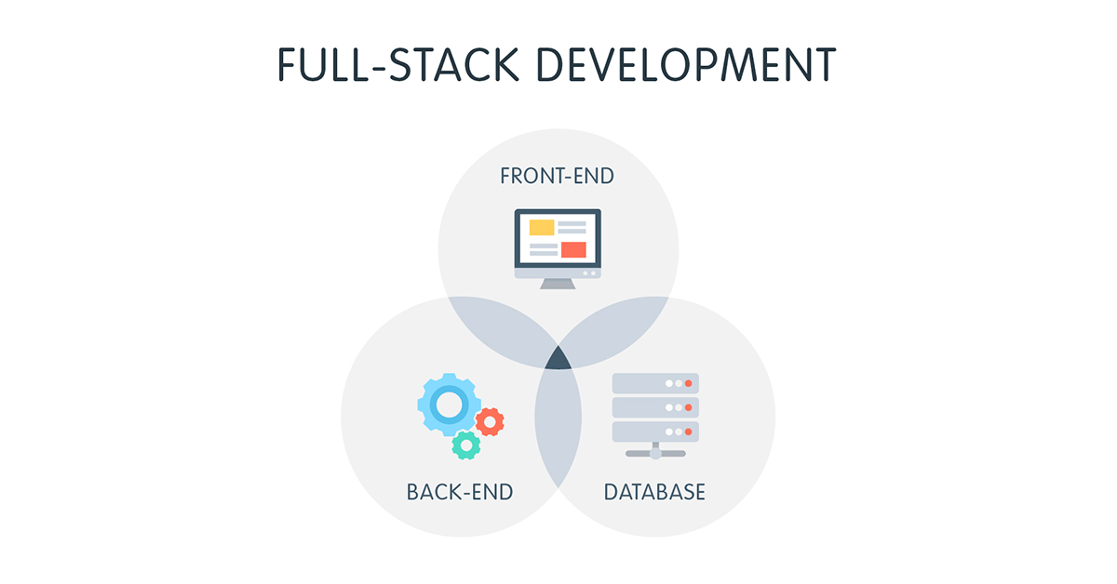
Next Time
Real Client
Style Guide
Full Stack?

Slide 24
Bibliography
text/office-reviews.txt: http://jmcauley.ucsd.edu/data/amazon/
Ups and downs: Modeling the visual evolution of fashion trends with one-class collaborative filtering
R. He, J. McAuley
WWW, 2016
http://cseweb.ucsd.edu/~jmcauley/pdfs/www16a.pdf
Image-based recommendations on styles and substitutes
J. McAuley, C. Targett, J. Shi, A. van den Hengel
SIGIR, 2015
http://cseweb.ucsd.edu/~jmcauley/pdfs/sigir15.pdf
Most Common Words in English
https://www.wordfrequency.info/

Slide 26
Reflections on teamwork. This is a slightly different kind of section. Imagine that your team has completed its project, each member did some other things, and now you're reconvening to work on the next project. How well did your planning, communication and coordination go? How do you think it can be improved? You are strongly discouraged from airing complaints you might have about specific interactions you had with teammates. Rather, you're encouraged to focus on what went well and particular strategies you want to try in your next teamwork experience to make things go even better.

